Slide 1
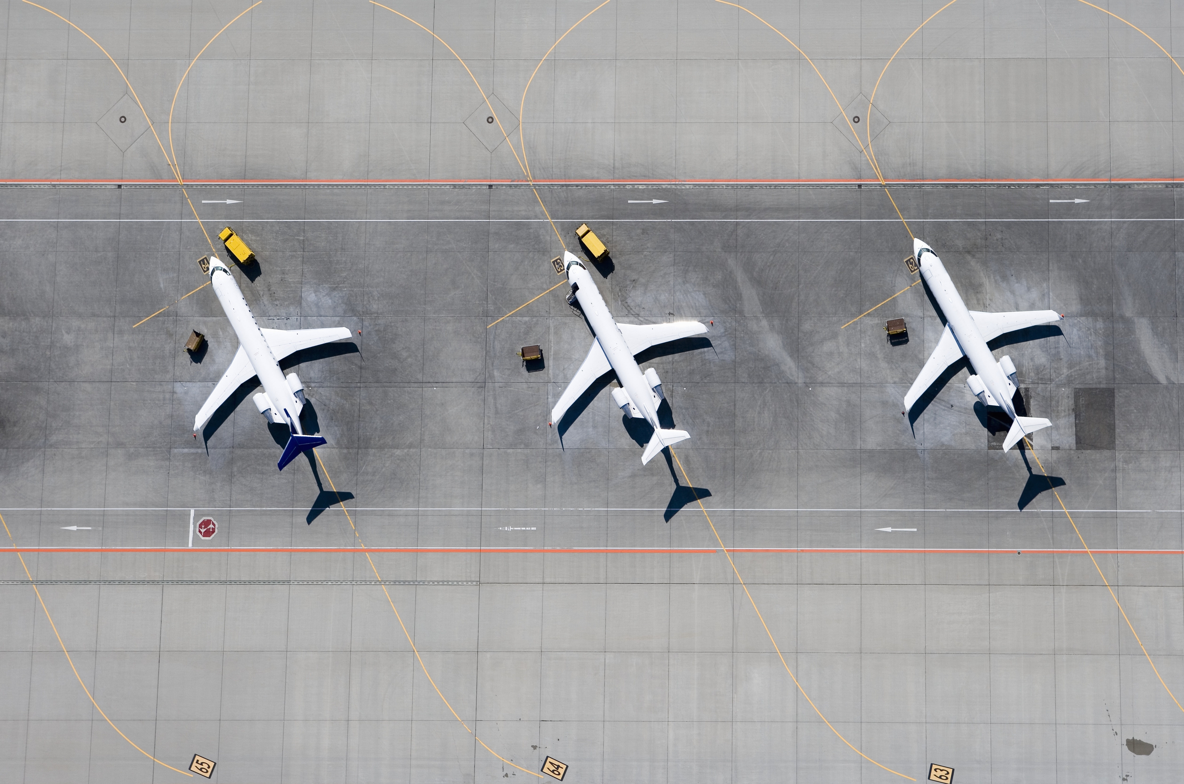
Predicting Flight Delays A Data-Driven Approach to Enhancing Airline Efficiency
Notes:
Introduction
Presentation will discuss our process of analyzing flight delays and creating predictive models to determine the length of these delays

Slide 2
AGENDA
The Problem
Data Analysis & Modeling
Recommendations
Going Forward
Notes:
Acknowledge that flight delays happen and the issues they cause for us and clients
Then we will talk about the data: where collected, what patterns we saw
Moving on to discussing the different models, the best model
Then the most important part of the presentation, we will discuss our finding and recommendations
Lasty, we have the items that we can do going forward to continue this research

Slide 3
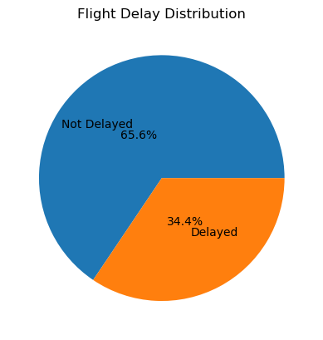
Acknowledging flight delays
Notes:
First we need to acknowledge that delays exist. For example, using data of domestic flights in the USA for the year 2018 (taken from the DOT’s Bureau of Transportation Statistics), we can see that just over one third of the flights were delayed.

Slide 4
The Impact of Flight Delays on Airlines
Operational Inefficiencies
Flight delays disrupt scheduling and complicate resource management.
These interruptions can lead to being over or understaffed in certain areas.
Financial Costs
Delays result in direct costs, such as passenger compensation and refunds.
Additional expenses arise from increased fuel consumption and the need for flight rescheduling.
Reputational Risks
Frequent delays can damage an airline's reputation and erode customer trust.
Negative experiences may lead to decreased customer loyalty and a loss of market share.
Notes:
Read the slide, then:
In order to combat this, we need analyze the delays and see if we can both predict and reduce the number of delays
The process we used had 4 main steps…

Slide 5
Data Analysis and Modeling
Data Collection
Data Cleaning
Modeling Techniques
Data Analysis
Notes:
They are (read the 4 steps). I will give a quick overview of each step in the following slides, to give a general idea of what we looked at.
If you would like a more in depth look at each of these steps, we can schedule another meeting later

Slide 6
Data Collection
Data Collection
2018 USA Domestic Flights
Airline and Airport Names
Data Cleaning
Modeling Techniques
Data Analysis
Combined Data Frame
Flight Information
Airline Names
Airport Names
Notes:
Data of all domestic flights in the USA for the year of 2018. this came from the department of Transportation’s bureau of Transportation Statistics
It only had the airline and airport codes, so we found dataframes with airport and airline names with their corresponding codes and added to the main data to make it easier to see the airports and airlines

Slide 7
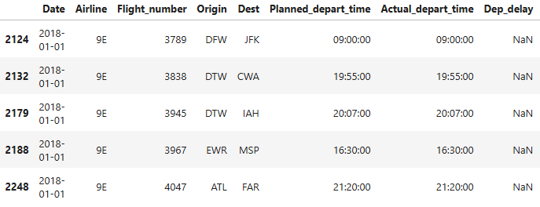
Data cleaning
Data Collection
Data Cleaning
Irrelevant Data
Missing & Incorrect Data
Modeling Techniques
Data Analysis
Notes:
Data cleaning addresses messy data to make it neat and organized. Here, started by removing irrelevant data, such as Time in the air.
We removed flights with missing data, and either corrected or removed flights with incorrect data. For example, NaN when the flight was on time

Slide 8
Data Analysis
Data Collection
Data Cleaning
Modeling Techniques
Data Analysis
Airline & Airports
Day, Month, & Time
Notes:
Once the data was cleaned, we analyzed the data for any patterns.
We looked at the airline and airports. Then at the day, month and time

Slide 9
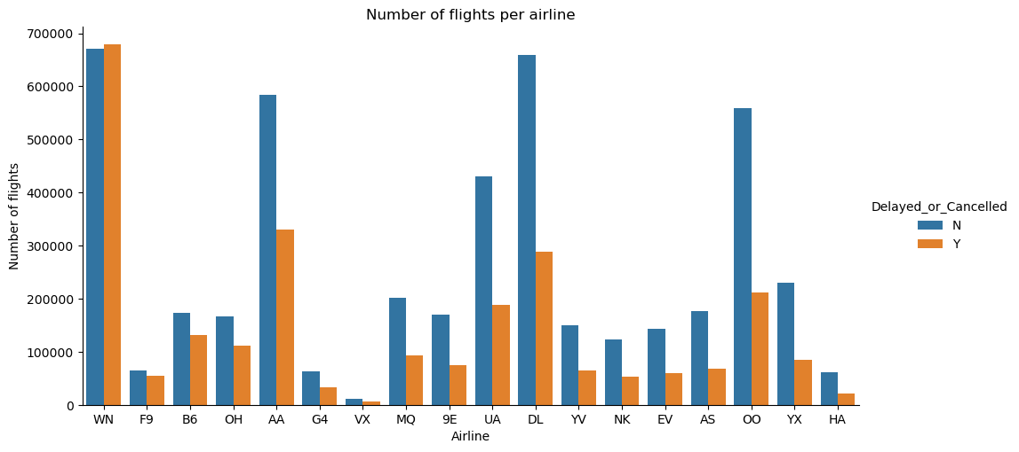
Data Analysis
Data Collection
Data Cleaning
Modeling Techniques
Data Analysis
Airline & Airports
Notes:
Once the data was cleaned, we analyzed the data for any patterns.
Airline: WN (southwest) has just over 50% of flights delayed. F9 (Frontier), B6( Jetblue), and OH (Jetstream Intl) have between 40-46% of flights delayed. The remaining are between 26-36%
More total flights does not equal more delayed flights. DL (delta) and OO (skywest) have a lot of flights, but their percentage delayed is lower than others with less flights.

Slide 10
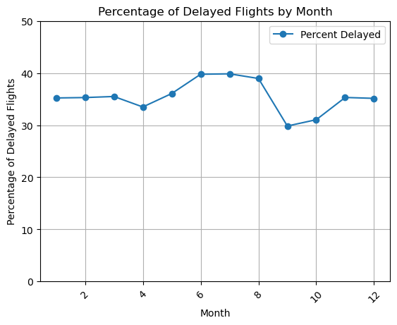
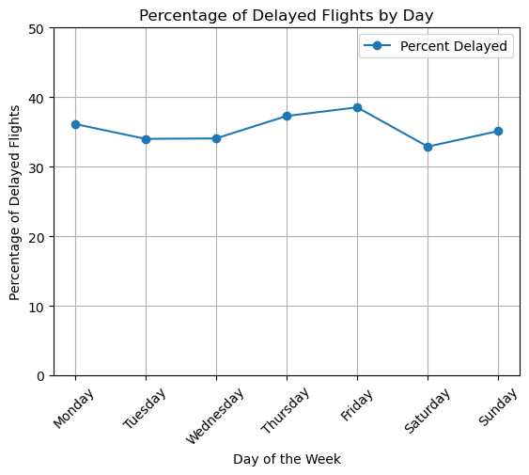
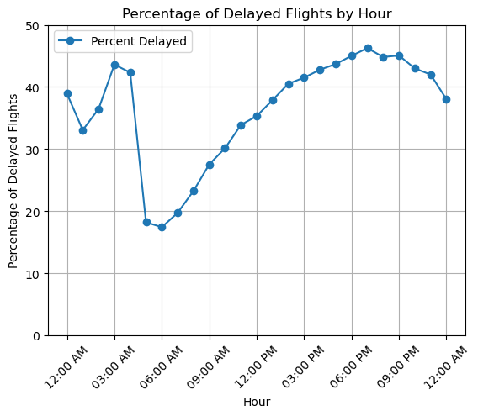
Data Analysis
Summer Months have the most delays
No noticeable difference between day of the week
More delays as the day progresses
Notes:
Month: summer months hover at just below 40%. September/October least at around 30%. The rest hold steady at around 35%
Week: consistent throughout the week, with only about a 6% difference from the lowest to the highest
Hour: delays increase as the day goes on, culminating in the evening hours of 6-9pm at 46%.
Without more data, it is hard to say for certain the cause of these patterns, but we can speculate that the summer has more severe weather and is busier with more families travelling, and as flights start to get delayed, they cause a cascade effect, causing subsequent flight to become delayed

Slide 11
Modeling
K Nearest Neighbors
Simple Baseline Model
Random Forest
LightGBM Categorical
Works well if there are strong similarities between flights
Good at capturing nonlinear relationships
More powerful than the tree based random forest model
Good at capturing interactions between different factors
Allows for categorical variables, eliminating the need for one-hot encoding
LightGBM &
XGBoost
Performed faster and better than the previous two
Added cyclical encoding to address day/year rollover
Data Collection
Data Cleaning
Modeling Techniques
LightGBM & XGBoost
Data Analysis
KNN & Random Forest
Notes:
Once we analyzed the data, we began building predictive models
KNN: too slow at predicting on a large dataset
Random Forest: Too slow on training

Slide 12
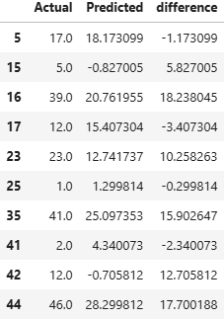
Modeling
Data Collection
Data Cleaning
Modeling Techniques
LightGBM & XGBoost
Data Analysis
KNN & Random Forest
MAE: 12.8 Minutes
Notes:
Best model gave us a Mean Absolute error of 12.8. This does not mean that every prediction will be off by 13 minutes. Some will be off by less than 13 minutes, while others by more than 13 minutes. So this means on average, the prediction is off by about 13 minutes. If we look at some examples on the right, we see that this applies in both directions as well. Some flights will be predicted to have a shorter predicted delay (Positive differences) while others will have a longer predicted delay (Negative differences)

Slide 13
Recommendations
Optimize resource allocation
Flight Schedule Adjustments
Advance Delay Notifications
Analyze historical flight data to identify and adjust consistently delayed flights
Inform passengers early, considering ±15 minutes error margin.
Schedule personnel based on predicted delay lengths.
Notes:
Timely notifications of delays enhance the passenger experience, leading to increased customer loyalty.
Improved predictions allow for better staffing and resource allocation, ensuring that personnel are available when needed.

Slide 14
Future Improvements for Flight Delay Predictions
Collect More Data
Track Flight Patterns
More data and features can help identify relationships and interaction between different factors, improving model performance. This can include:
Reason for the delay
Weather Conditions
Data from multiple years
Tracking the same flights throughout the year to identify if there are specific flights that are always delayed.
Tracking the same plane throughout the day to determine if there is a cascade effect that contributes to delays.
Notes:
Currently, the model only explains about 16% of the variance in the data, or in other words, only 16% of the changes in flight delays are accounted for by the model, with the rest being unexplained. To improve upon this we can… Collect more data… Track Flight Patterns

Slide 15

conclusion
Predictive analytics empower airlines to take control of delays.
A data-driven approach can improve efficiency, customer satisfaction, and therefore profitability.
With data, the sky is the limit.

